Slide 1




Enhancing Traffic Safety Through Data-Driven Analysis
PRESENTED BY
Madhulika Gangarajula

Slide 2
INDEX
Introduction
Generation
Collection
Processing
Storage
Management
Analysis
Visualization
Interpretation
Conclusion

Slide 3
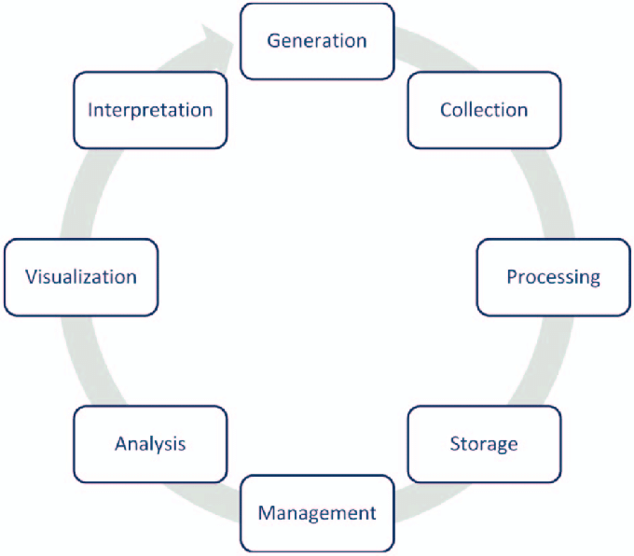
DATA LIFECYCLE
The data lifecycle is the journey of data from its creation or acquisition, through various stages of processing and analysis, to ultimately deriving valuable insights or making informed decisions.

Slide 4

Introduction
Traffic safety is a critical concern worldwide, with millions of lives lost or impacted by accidents each year. Despite advancements in technology and infrastructure, the need for effective strategies to improve traffic safety remains pressing. To address this challenge, we propose leveraging data-driven analysis to identify key factors contributing to traffic accidents and develop targeted interventions aimed at reducing accident rates and improving overall road safety.

Slide 5
Generation
We obtained our data from the 'data.gov' dataset. Our dataset includes detailed records of traffic collisions from 2010 to the present. Centered on occurrences within the boundaries of Los Angeles, granting insights tailored to the area.
The dataset comprises the following columns: DR Number, Date Reported, Date Occurred, Time Occurred, Area ID, Area Name more.

Slide 6
Collection & Processing
We gathered and processed the raw data to clean it up, make it consistent, and get it ready for analysis.
We've collected 600,000 records of data and addressed missing values, duplicates, resulting in a reduction to 17,000 data records.

Slide 7
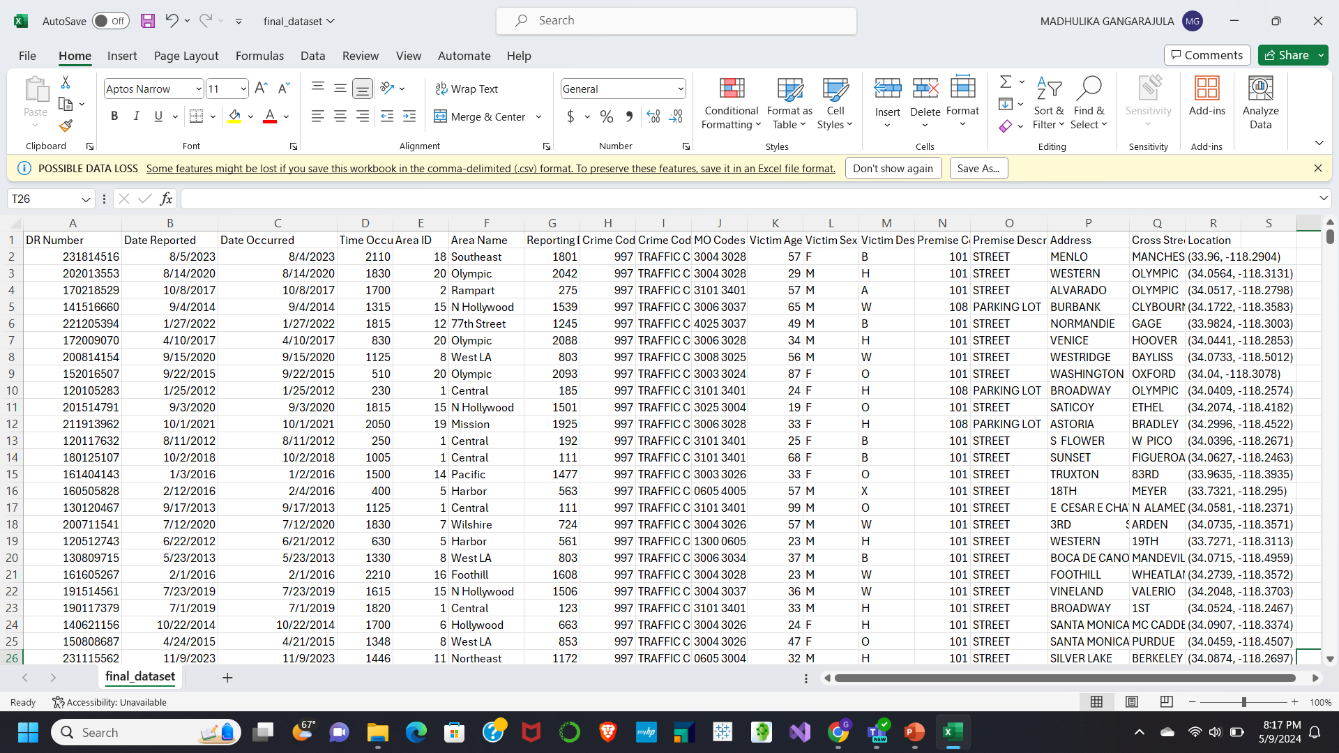

Slide 8
Storage & Management
The cleaned dataset was stored on Google Cloud Platform (GCP), with a new project called ADTA5240FPMG, and a storage bucket set up to hold the data.
Configured access permissions for users or services that need to interact with the dataset.

Slide 9
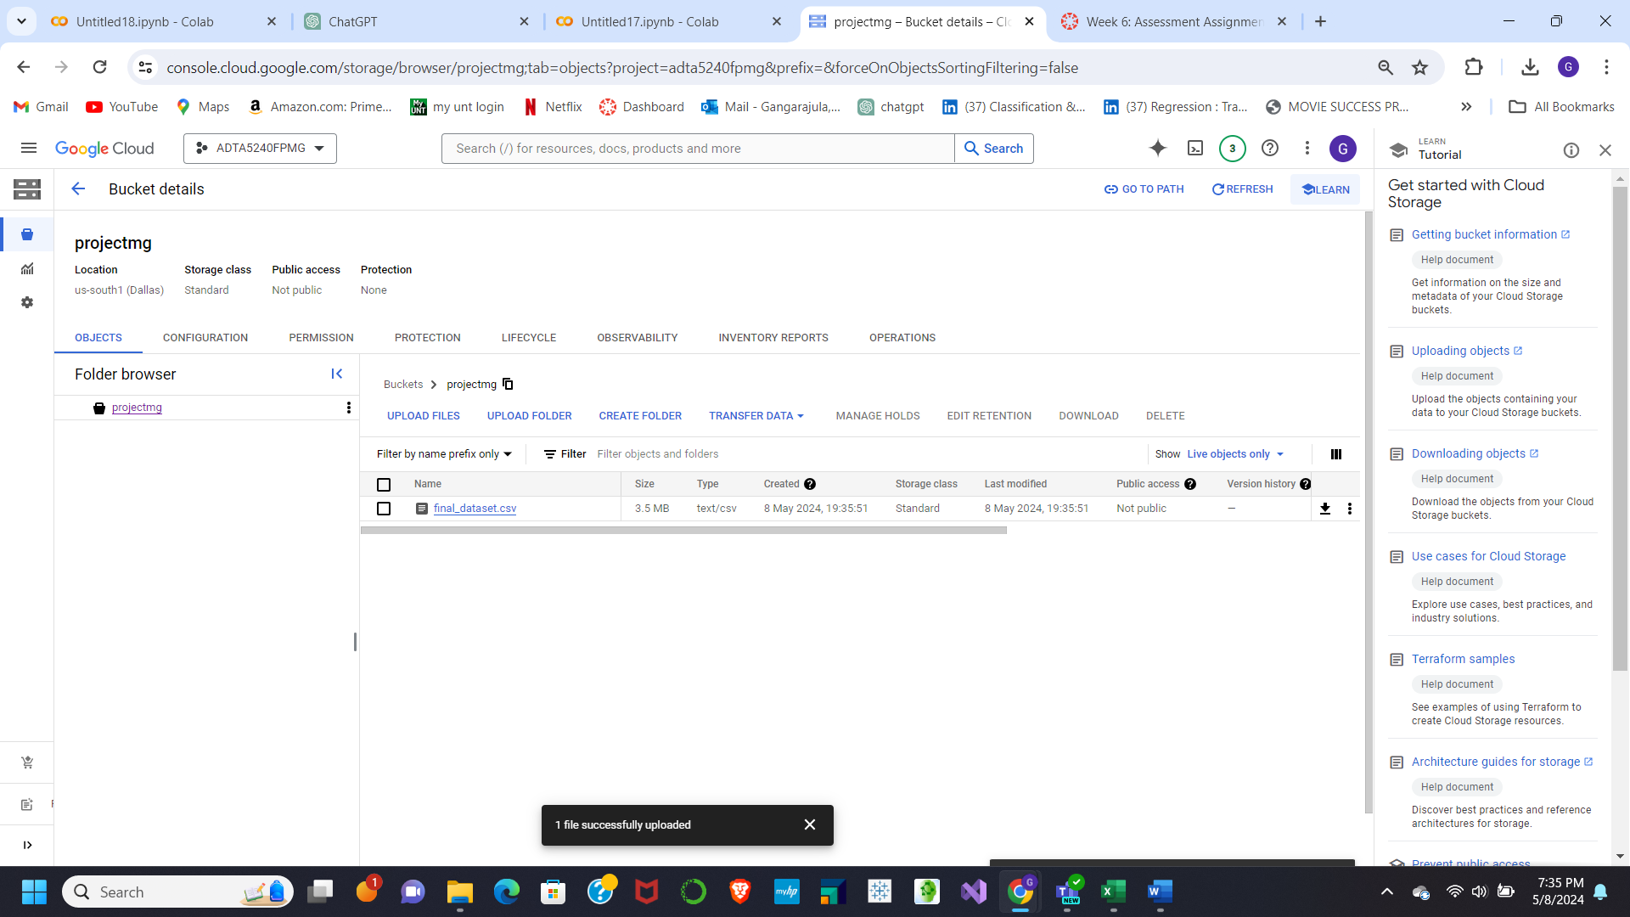

Slide 10
Analysis
The data was uploaded to BigQuery on Google Cloud Platform (GCP), where we used SQL commands to analyze the dataset and uncover insights.
Our analysis involved running queries to pinpoint the prime accident spots, determining daily accident counts, categorizing victim age groups, and assessing accident rates based on gender and location.

Slide 11
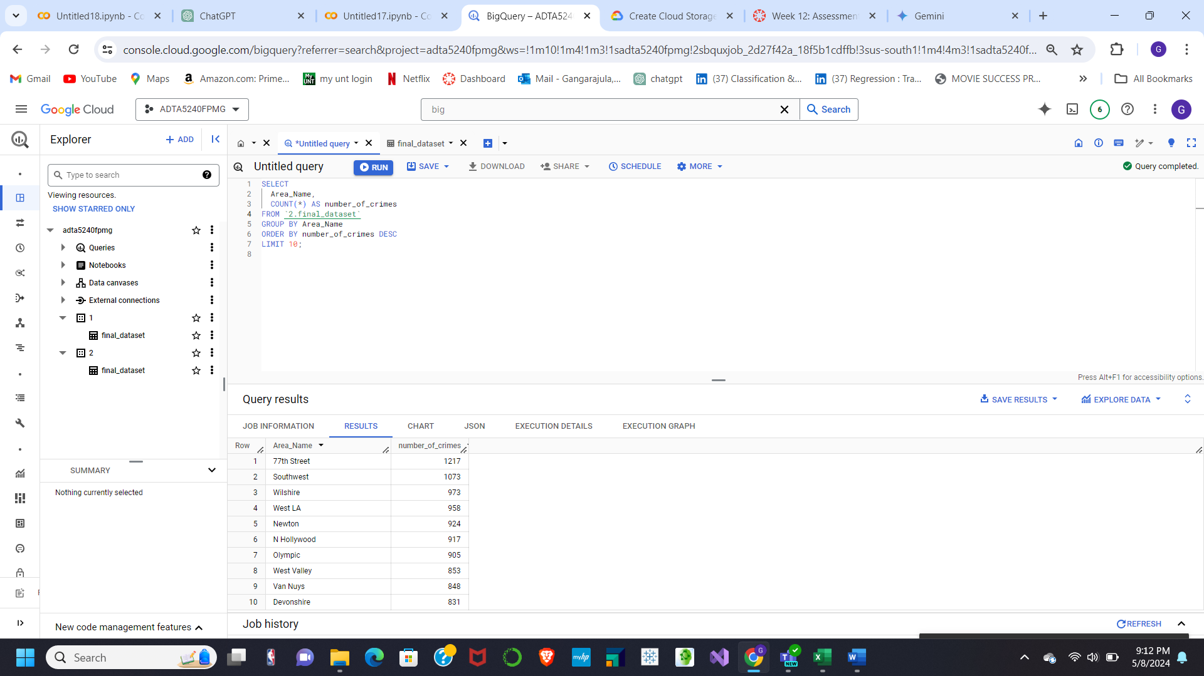

Slide 12
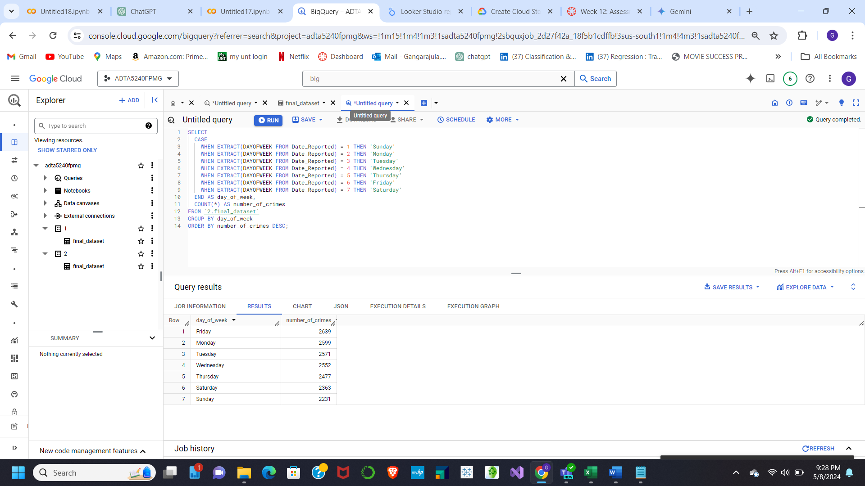

Slide 13
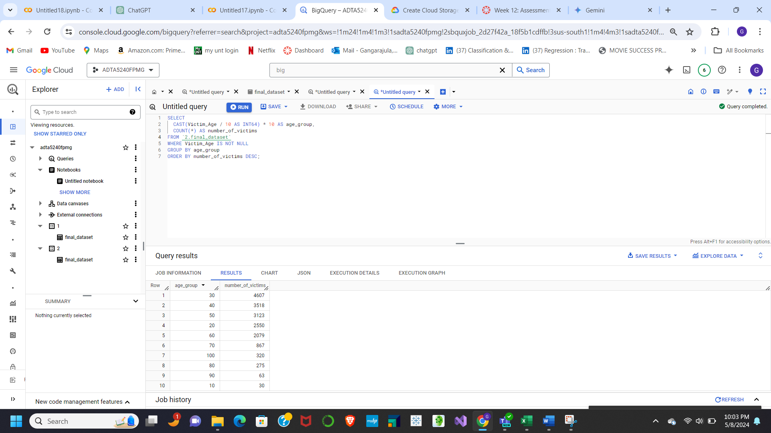

Slide 14
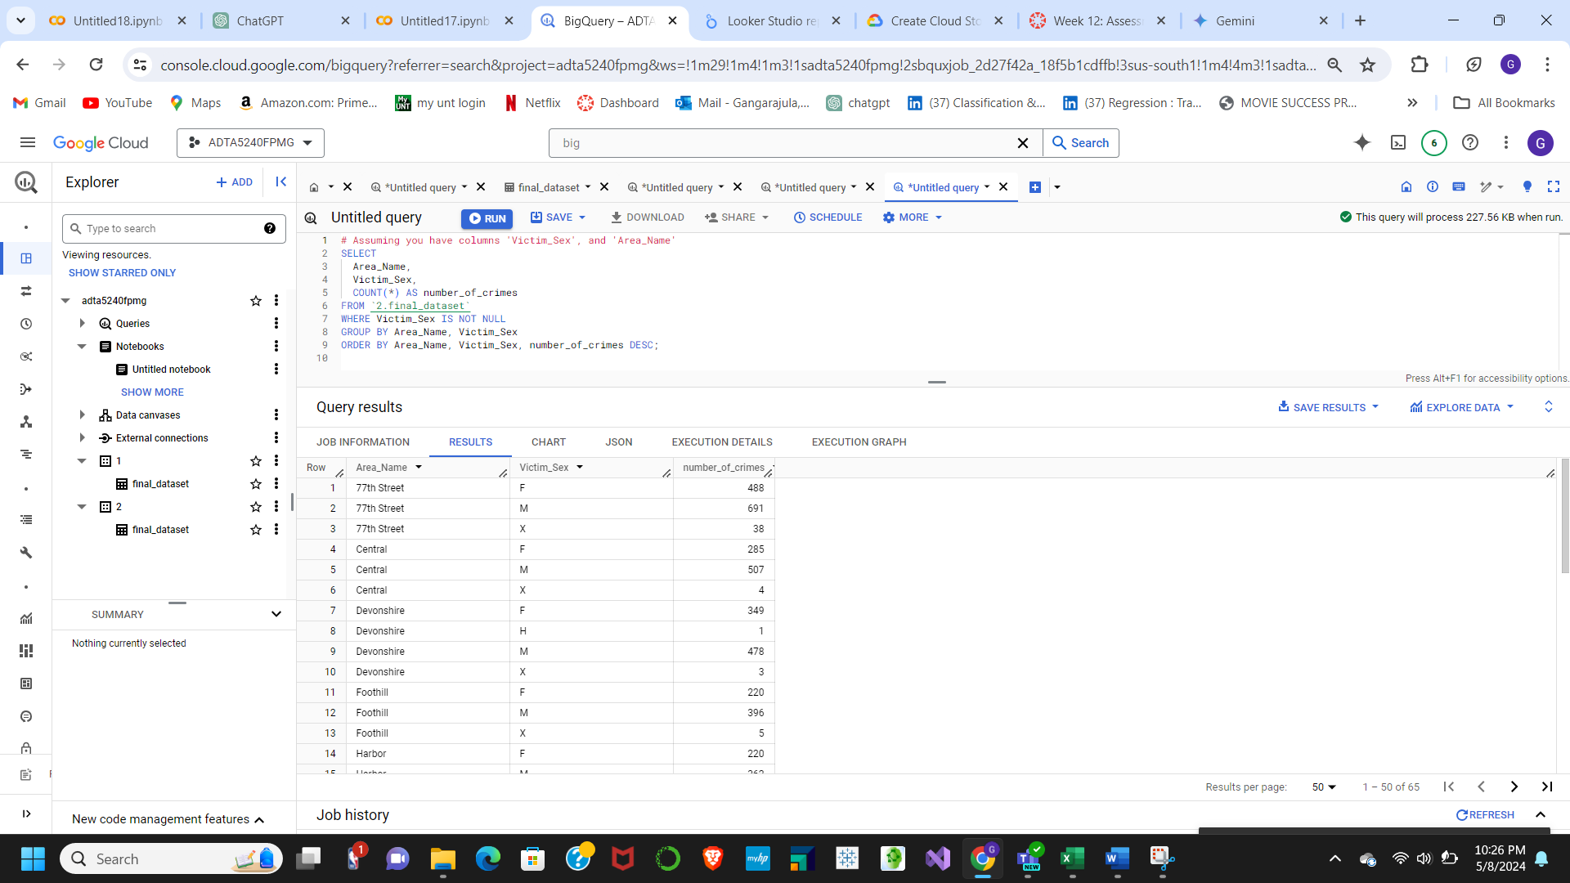

Slide 15

Visualization
The data visualization step included making different types of charts and graphs to illustrate insights from the dataset. For example, a bar graph displays the number of traffic accidents by location, segmented to reveal patterns by time of day or day of the week. A pie chart shows the distribution of crimes by day of the week, while a line graph serves as a crime data dashboard, indicating crime rates by gender and area.

Slide 16
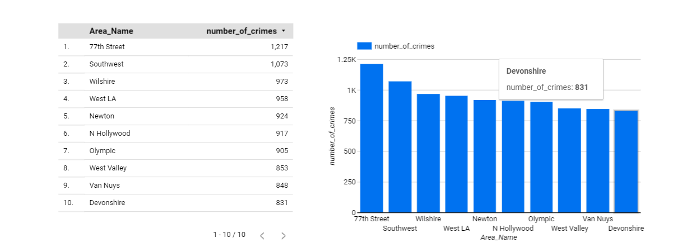
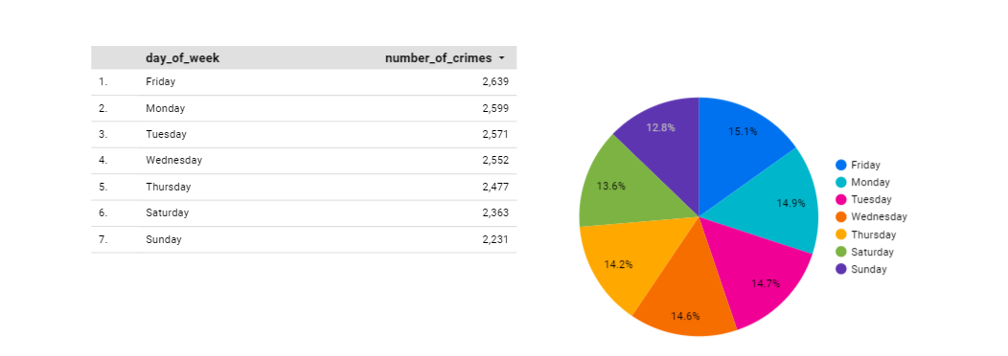

Slide 17
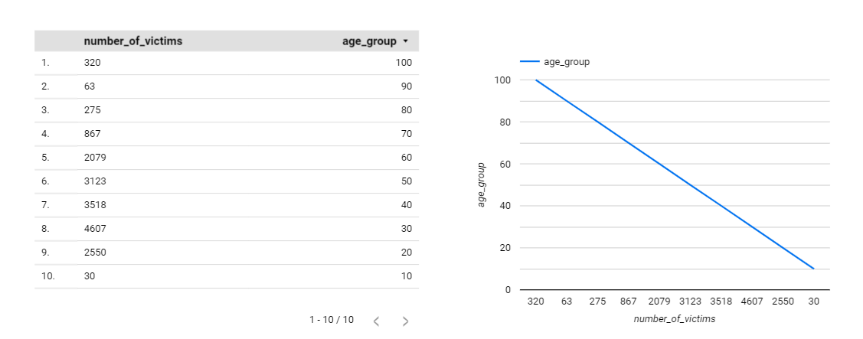
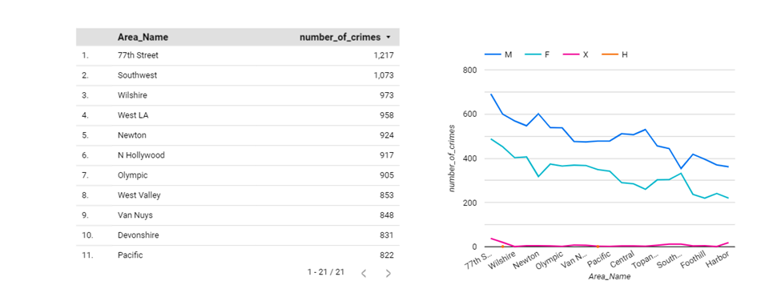

Slide 18
Interpretations
Criminology research indicates that males typically commit more crimes than females. So, if our data aligns with this trend, we might observe consistently higher crime counts in the "M" category compared to "F" across most areas.
Certain areas may consistently exhibit higher overall crime rates, regardless of gender. These areas could merit further investigation to understand potential contributing factors such as poverty, unemployment, or gang activity.
Additionally, variations in crime rates among different areas might suggest disparities in socio-economic conditions or law enforcement efforts, highlighting the need for targeted interventions tailored to each locality.
Analyzing gender-specific crime patterns alongside area-specific trends can provide a comprehensive understanding of the factors influencing criminal behavior, guiding policymakers in formulating effective crime prevention strategies.

Slide 19
Conclusion
This project showcased how data-driven analysis improves traffic safety. By collecting and processing traffic accident data, valuable insights were gained into accident distribution and patterns. Analysis, visualized through various charts and graphs, revealed that accidents are not evenly distributed across locations. Specific findings included higher concentrations at intersections or on particular highways and potential correlations with factors like time of day or day of the week. These insights can inform traffic safety initiatives by focusing resources on high-risk locations and times. Authorities can potentially prevent accidents and save lives by targeting interventions effectively. Additionally, the data can guide infrastructure improvements such as better signage or traffic calming measures in high-accident areas.

Slide 20

Thank You

